Slide 1
Creating a Dynamic 127 Music Bar Experience
Group-1
19 Aug 2023

Slide 2
Vision/Mission
"To establish 127 Music Bar as a premier virtual destination for music enthusiasts, fusing innovative web design with the lively ambiance of a music bar."

Slide 3
Scope and Limitation
Scope: Developing a responsive Bootstrap website for 127 Music Bar.
Limitations:
Time: Project completion targeted within 10 days.
Programming Language: HTML, CSS, JavaScript (Leveraging the Bootstrap framework).

Slide 4
Feasibility Study
Technical Feasibility: Bootstrap provides a robust foundation for responsive design.
Operational Feasibility: The project aligns with the team's expertise and available resources.

Slide 5
Team Leader and Members
1. U Zaw Zaw Htet (L)
2. U Pyae Phyo Si
3. U Soe Soe Kyaw
4. Daw May Thu Han
5. Daw Myat Mon Khine
6. Daw Nwe Ni win
7. Daw Nan Thinzar Myint Aung
Activities: UI/UX design, frontend development, backend integration, content creation, testing, deployment.

Slide 6
Proposed Business Type
Business Type: Entertainment & Recreation

Slide 7
Estimated Budget
Total Budget: USD 3000 ($X + $Y + $Z + $W)

Slide 8
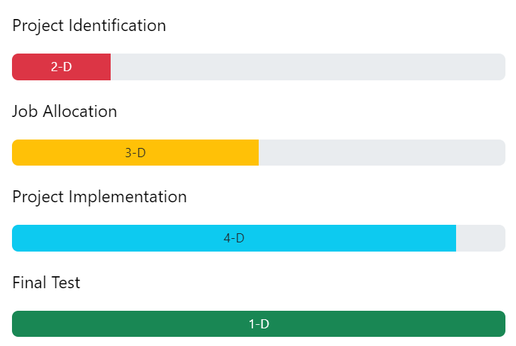
Development and Testing Process

Slide 9
Security Point of View
Robust Authentication: Hashed passwords, stringent login mechanisms.

Slide 10
Expected Outcome and Impact
Outcome: An engaging, intuitive web platform that captivates music enthusiasts.
Impact:
Elevated interaction and engagement within the music community.
Amplification of emerging artists and music events.

Slide 11
Thanks for your Attention!

